Slide 1
Uni-X
Regression Analysis on College Scorecard Data
Nov. 29th 2017
Group members: Ahlam Hakami
Bin Luo
Qi Zhang

Slide 2
Goals:
What variables can affect repayment rates?
Estimate repayment rates based on other variables.
Predict repayment rates in coming years.

Slide 3
Compare male and female repayment rate
 | T value | P value
1 Year | -2.4751 | 0.0133
3 Years | -1.5119 | 0.1306
5 Years | -0.3821 | 0.7024
7 Years | 0.0588 | 0.9531

Slide 4
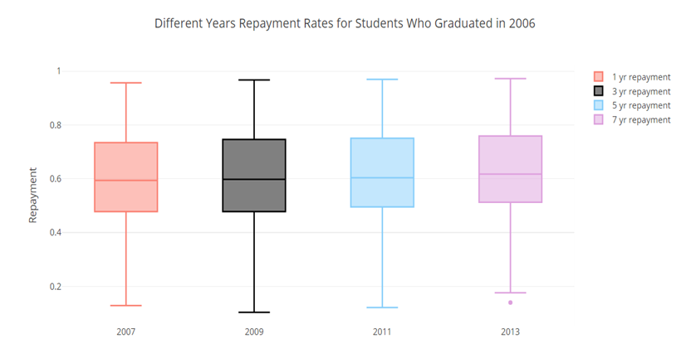
Since the different years repayment rates are about the same for the same group of people, we only focus on 1 year repayment rate.

Slide 5
What we have done so far:
Found highly correlated explanatory variables.
Deleted the variables with small standard deviation.
Used PCA to reduce dimension.
Fitted a regression model using principal components.

Slide 6
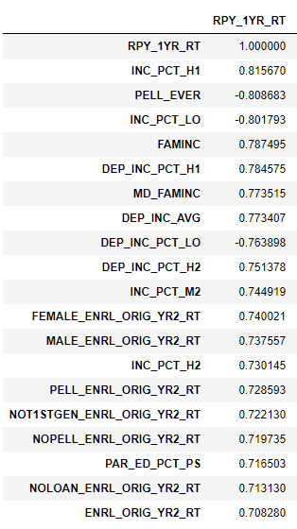
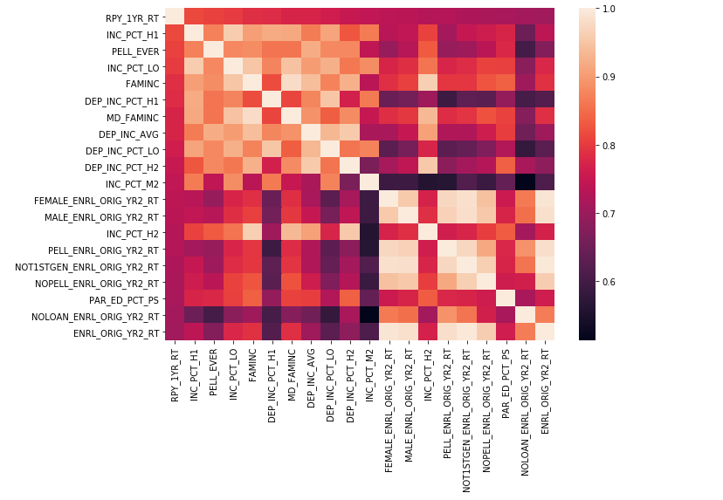
Top 200 highly correlated variables with 1 Yr RPY

Slide 7
After delete variables with small standard deviation (< 0.15 )
Variable Name |  | Variable Name
PELL_EVER | Share of students who received a federal loan which in school | FEMALE_ENRL_ORIG_YR2_RT | % of female students who were still enrolled at original institution within 2 years
INC_PCT_LO | % of aided students whose family income is $0-30,000 | MALE_ENRL_ORIG_YR2_RT | % of male students who were still enrolled at original institution within 2 years
FAMINC | Average family income in real 2015 dollars | PELL_ENRL_ORIG_YR2_RT | % of students who received a Pell Grant and who were still enrolled at original institution within 2 years
MD_FAMINC | Median family income in real 2015 dollars | NOT1STGEN_ENRL_ORIG_YR2_RT | % of not-first-generation students who completed within 2 years at original institution
DEP_INC_AVG | Average family income of dependent students in real 2015 dollars | NOPELL_ENRL_ORIG_YR2_RT | %of students who never received a Pell Grant at the institution and who were still enrolled at original institution within 2 years
DEP_INC_PCT_LO | % of students who are financially dependent and have family income $0-30,000 | NOLOAN_ENRL_ORIG_YR2_RT | % of students who never received a federal loan at the institution and who were still enrolled at original institution within 2 years

Slide 8
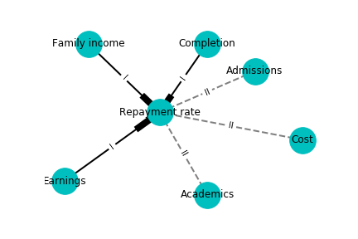
We have very similar variables for each feature, a PCA was conducted to deduce the dimension.

Slide 9
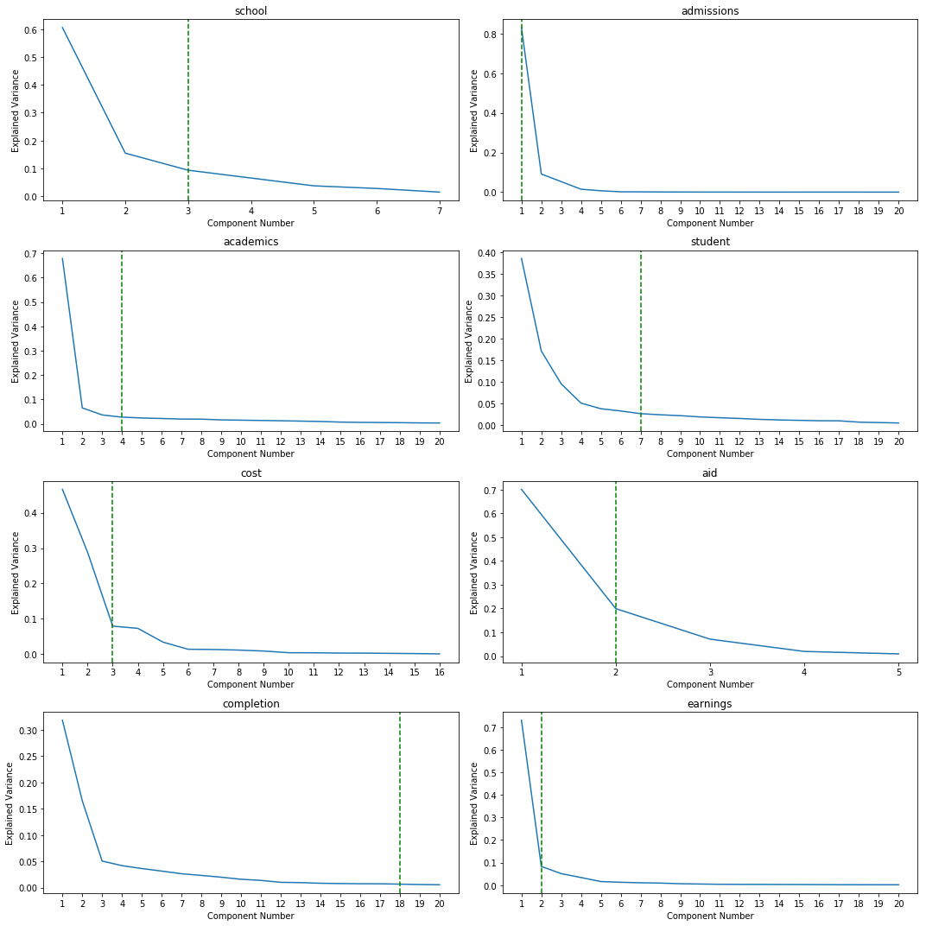
Dimension Reduction by PCA

Slide 10
Linear Regression
Response variable: log(y/(1-y)), where y is repayment rate
Explanatory variables: 40 components from all categories
Total number of observation: 35027
R-squared=0.829
Cross-validation MSE: 0.766 (on transformed response variable)

Slide 11
Model Evaluation
Try to plot the validation curve with different variance threshold on PCA...

Slide 12
Questions?

